Slide 1
Chapter – 4
Carbon and its compounds
- Bonding In Carbon
- Versatile Nature Of Carbon
Notes:
Slide: 1

Slide 2
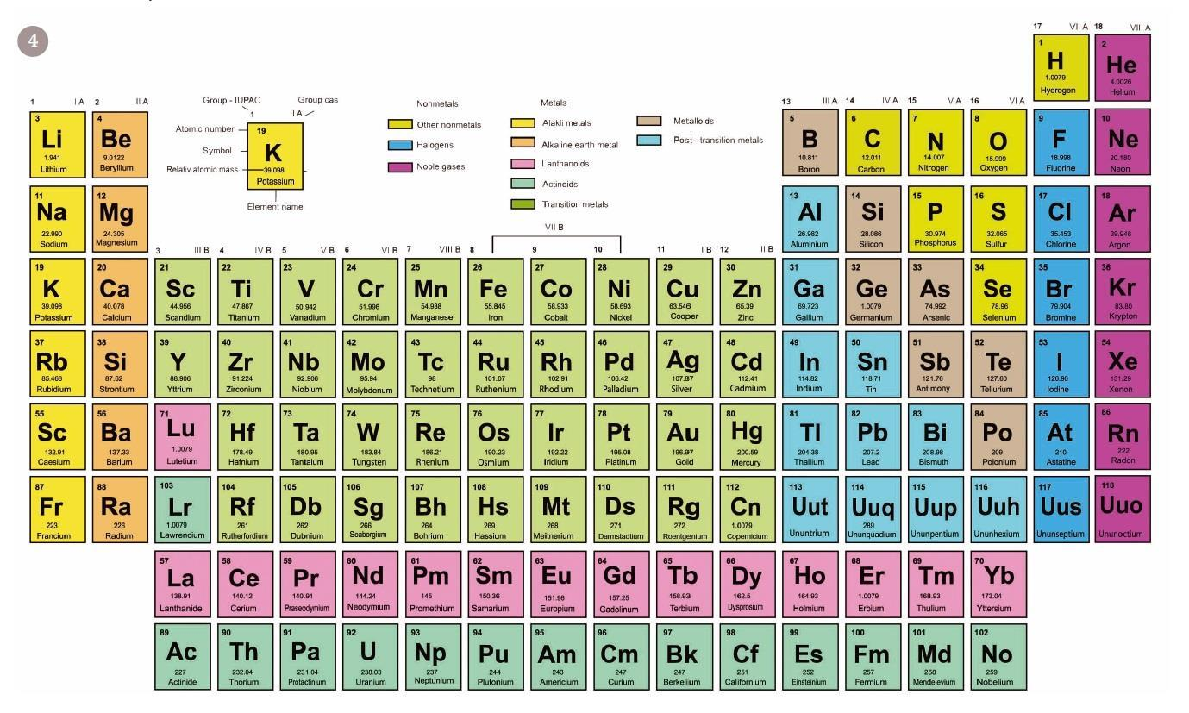
Notes:
Slide: 2
Tell students About the Importance of Periodic Table.
The periodic table is important because it is organized to provide a great deal of information about elements and how they relate to one another in one easy-to-use reference.
The table can be used to predict the properties of elements, even those that have not yet been discovered.
Learning Periodic table from Unit 4 is always recommended.

Slide 3
What Is Carbon ?
CARBON is the chemical element with symbol C
Atomic number 6.
A member of group 14 on the periodic table.
Nonmetallic and tetravalent.
Making four electrons available to form covalent chemical bonds.
There are three naturally occurring isotopes.
12C and 13C being stable, while 14C is radioactive.
Notes:
Slide: 3
1. Represented by C.
2. Atomic number 6.
3. Member of group 14.
4. Four electrons.
5. Three naturally occurring isotopes.

Slide 4
Occurrence Of Carbon
Carbon is found in the atmosphere
Inside the earth’s crust and in all living organisms.
Carbon is present in fuels like wood, coal, charcoal, coke, petroleum, natural gas, biogas, marsh gas etc.
Carbon is present in compounds like carbonates, hydrogen carbonates etc.
Carbon is found in the free state as diamond, graphite, fullerenes etc.
Notes:
Slide: 4
Found in the atmosphere.
Found in earth’s crust.
Present in wood, coal, charcoal, coke, petroleum, natural gas, biogas, marsh gas.
(Pic is a GIF. Wait)

Slide 5
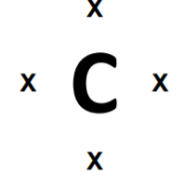
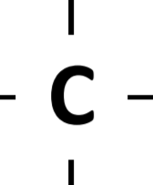
Bonding In Carbon Covalent Bond
The atomic number of carbon is 6
Its electronic arrangement is 2,4, it has 4 valence electrons.
It can attain stability by gaining 4 electrons, losing 4 electrons or sharing 4 electrons with other atoms.
It does not gain 4 electrons because it is difficult for the 6 protons to hold 10 electrons.
It does not lose 4 electrons because it needs a large amount of energy to lose 4 electrons.
Notes:
Slide: 5
atomic number of carbon is 6.
It has 4 valence electrons.

Slide 6
Formation Of Covalent Bond
Covalent bond is chemical bond formed by the sharing of electrons between atoms.
Sharing of one pair of electrons results in the formation of single covalent bond.
Sharing of two pairs of electrons results in the formation of double covalent bond.
Sharing of three pairs of electrons results in the formation of triple covalent bond.
Notes:
Slide: 6
Formation Of Covalent Bond
1. Covalent bond is chemical bond.
2. Sharing of one pair of electrons results in the formation of single covalent bond
3. Sharing of two pair will form double covalent bond
4. Sharing more than two bond will form triple covalent bond.
Eg :- Formation of single covalent bond in Hydrogen molecule - H2 The atomic number of hydrogen is 1, its electronic arrangement is 1, it has 1 valence electron. It needs 1 electron more to attain stability. So two hydrogen atoms share 1 pair of electrons resulting in the formation of a single covalent bond in hydrogen molecule H2.

Slide 7
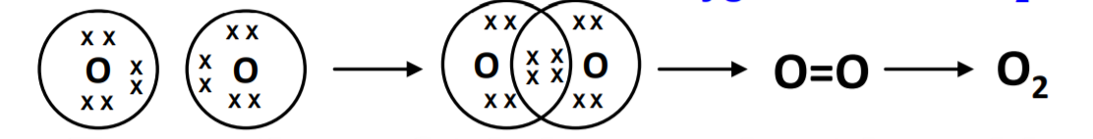
Formation Of Double Covalent Bond In Oxygen
The atomic number of oxygen is 8, its EC is 2,6, it has 6 VE,
It needs 2 electrons more to attain stability.
So two oxygen atoms share two pairs of electrons resulting in the formation of a double covalent bond in oxygen molecule O2.
O
+
O
O=O
O₂
Notes:
Slide: 7
1. Atomic Number of oxygen is 8.
2. O + O = OO = O2.

Slide 8
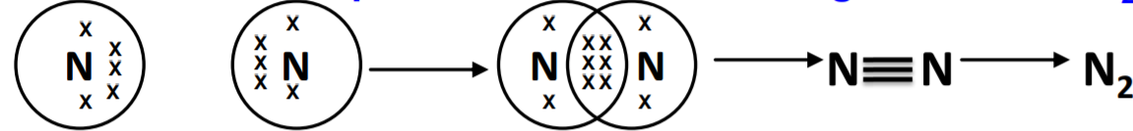
Formation Of Triple Covalent Bond In Nitrogen
The atomic number of nitrogen is 7, its EC is 2,5, it has 5 VE.
It needs 3 electrons more to attain stability.
So two nitrogen atoms share three pairs of electrons resulting in the formation of a triple covalent bond in nitrogen molecule N2
N
+
N
N ≡N
N₂
Notes:
Slide: 8
1. The atomic number of nitrogen is 7.
2. N + N = NN = N2.

Slide 9
Homologous Series
A series of carbon compounds in which same functional group substitutes the hydrogen atom is called a homologous series.
These compounds have similar chemical properties
Due to the addition of same kind of functional group throughout the chain.
For example, the series of alkanes i.e. Methane, ethane, propane, butane and so on.

Slide 10
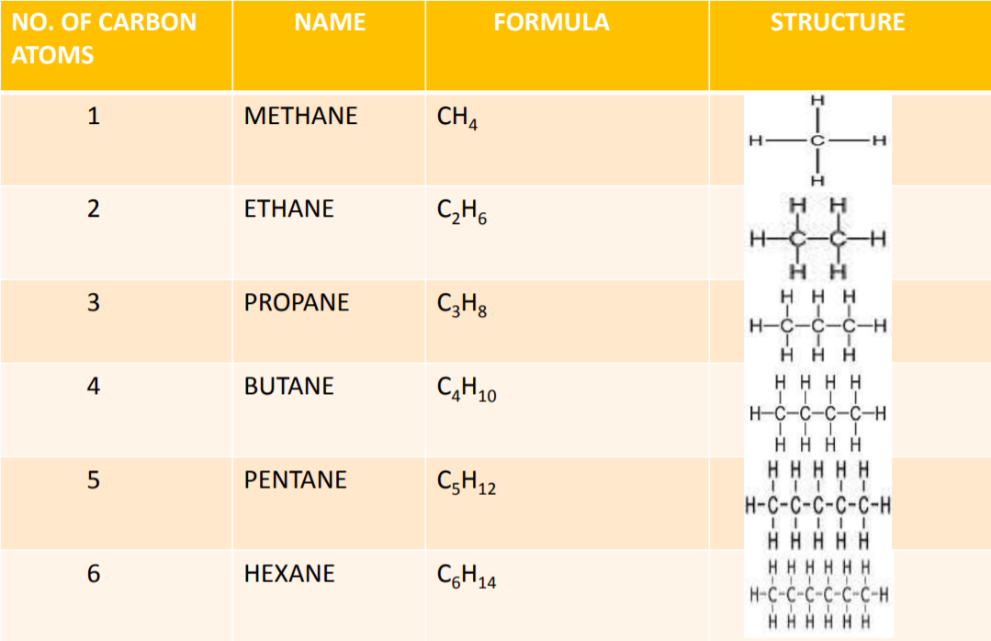
Structure of Saturated Hydrocarbon
Notes:
Methane - Methane is the simplest hydrocarbon, consisting of one carbon atom and four hydrogen atoms.
Ethane - ethane is a colorless, odorless gas. Like many hydrocarbons, ethane is isolated on an industrial scale from natural gas and as a petrochemical by-product of petroleum refining.
Propane - Propane is a three-carbon alkane with the molecular formula C₃H₈. It is a gas at standard temperature and pressure, but compressible to a transportable liquid.
Butane - Butane is an organic compound with the formula C4H10 that is an alkane with four carbon atoms.
Pentane is an organic compound with the formula C5H12—that is, an alkane with five carbon atoms.
Hexane - Hexane is an alkane of six carbon atoms, with the chemical formula C6H14.

Slide 11
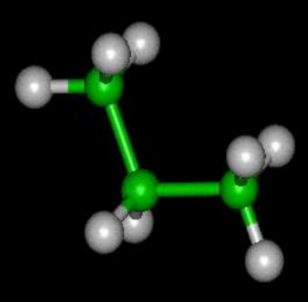
Straight Chains
A hydrocarbon can contain one carbon atom, as in methane or thousands of carbon atoms, as in cellulose.
Notes:
In the straight-chain alkanes, each carbon is bound to its two neighbors and to two hydrogen atoms. Exceptions are the two terminal carbon nuclei, which are bound to only one carbon atom and three hydrogen atoms.
CH₃ - CH₂ - CH₂ - CH₂ - CH₃ CH₃ - CH₂ - CH₃

Slide 12
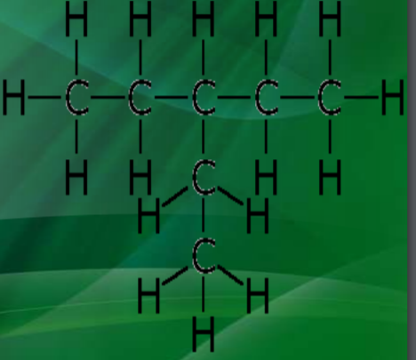
Branched Chains
Carbon has an ability to form branches with other carbon atoms. Simple branched alkanes often have a common name using a prefix to distinguish them from linear alkanes, for example npentane, isopentane, and neopentane. IUPAC naming conventions can be used to produce a systematic name.
Notes:
Branched-chain alkanes. Branched-chain alkanes are alkanes that contain only C and H (with only C-C single bonds) but are not linear.

Slide 13
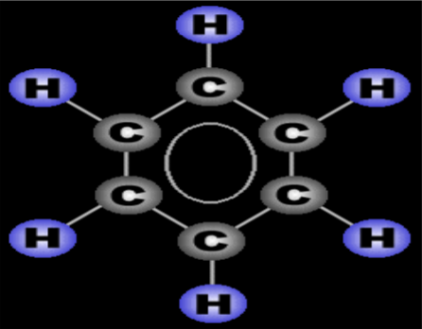
The Ring Or Cyclic
Carbons can be arranged in the form of a ring or cyclic, such as cyclobutane , Benzene etc .
Notes:
A cyclic compound (ring compound) is a term for a compound in the field of chemistry in which one or more series of atoms in the compound is connected to form a ring.

Slide 14

Thank You

